Slide 1



A Project Report on
Farm-Help Management
SUBMITTED TO
MTES’s Smt. G. G. Khadse College, Muktainagar.
Guidance by - Mrs Vandana V. Chaudhari
Presented by – Hitesh Prakash Mali

Slide 2
Introduction
Modern agricultural equipment's make farmers work more efficient and easy. As a part of which there are some organizations that are set up to help those farmers who are in need of such equipment's, where the organization owns the equipment's and rent those on request of farmers at liable amounts. At present, farmers need to travel to a place to borrow all the essential needs, which is a tiresome and not a cost effective work. So, a smart digital farming is listed as the highest ranking technology opportunity in the latest Global Opportunity report in terms of its expected positive impact on society.

Slide 3
Proposed System
The proposed system aims to develop a dynamic and user-friendly Management using Python. This project is designed to provide an online platform for a farming system, allowing customers to browse products, place orders, and manage their prescriptions. Technology Stack:
Frontend: Python and PyQt5
Database: Firebase Realtime Database
Key Features:
User Authentication: Secure user registration and login functionalities. Differentiate between customers and administrators with distinct access levels.
2. Product Catalog: Display a comprehensive catalog of Equipment’s, Fertilizers, Land Lease and other Coming Soon products. Include product details, images, and pricing information.
3. Shopping Cart and Checkout: Enable users to add products to a shopping cart for easy ordering.

Slide 4
Need of the System
When creating a Farm-help Management as a app using Python and the Php MySQL server framework, there are several needs and advantages. Here are some key points to consider:
Product Functions: Agriculture is a labor intensive job and that needs for deployment of machines in the farm. These machines can carry out farming operations much faster than the human labor. But these farming equipment and machinery are often very expensive & not every farmer is able to purchase it.
II. User Characteristics: Our design vision is such that the system should do the majority of the work for the user. The user just needs to interact with the system to state their needs.
III. Specific Constraints: With the increasing demand for farming machinery, it can be extremely difficult for equipment rental companies to keep up with mounting needs.

Slide 5
Software & Hardware Requirements
Software Requirements:
1. Operating System: Windows, Linux, or macOS.
2. Web Browser: Latest versions of browsers like Google Chrome, Mozilla Firefox, Safari, or Microsoft Edge.
3. Text Editor/IDE: Choose a code editor or integrated development environment (IDE) for coding in Python or PyQt5. Examples include Visual Studio Code, PyCharm
4. Database: Choose a database backend supported by Firebase Realtime Database. Install and configure it accordingly.

Slide 6
Hardware Requirements:
Processor: A modern multi-core processor for better performance.
2. Memory (RAM): At least 4GB of RAM for a development environment. More for production.
3. Storage: Adequate storage space for the operating system, development tools, and project files.
4. Network Connectivity: Required for downloading dependencies, updates, and potential integration with other systems

Slide 7
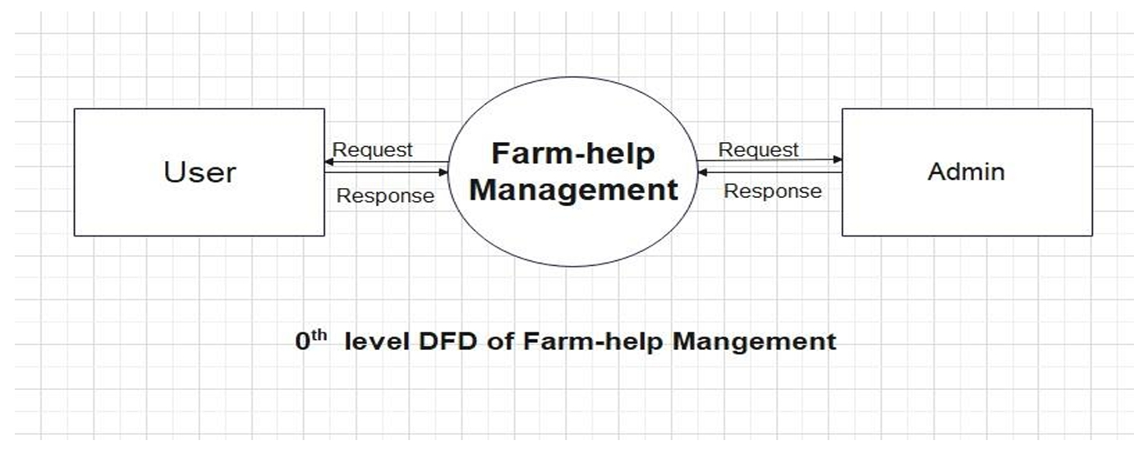
Database Diagram
$0^{th}$Level DFD:

Slide 8
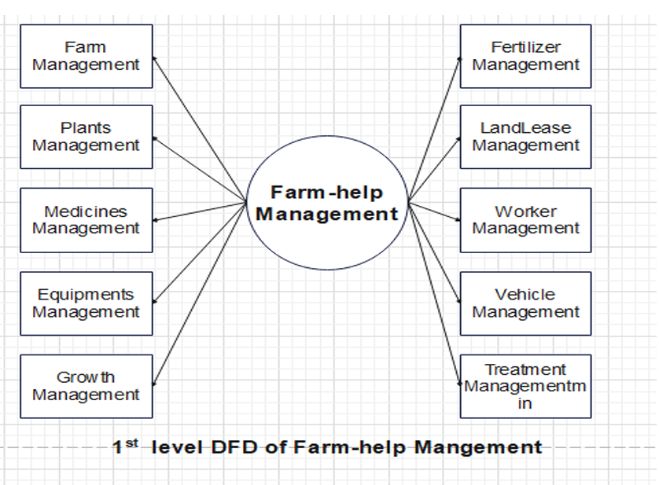
$1^{st}$ Level DFD:

Slide 9
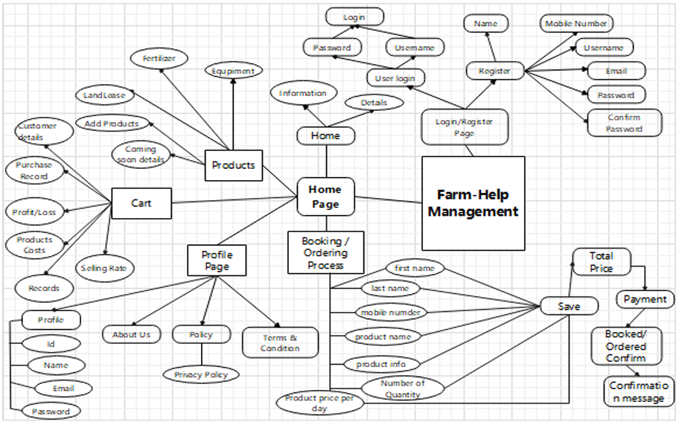
ER Diagram:

Slide 10
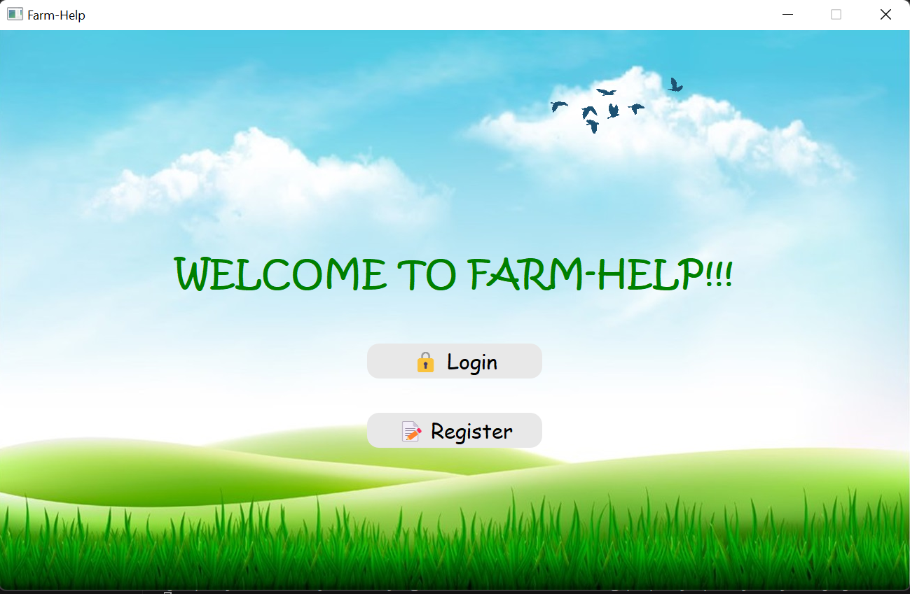
Project Screenshot
1. Homepage:

Slide 11
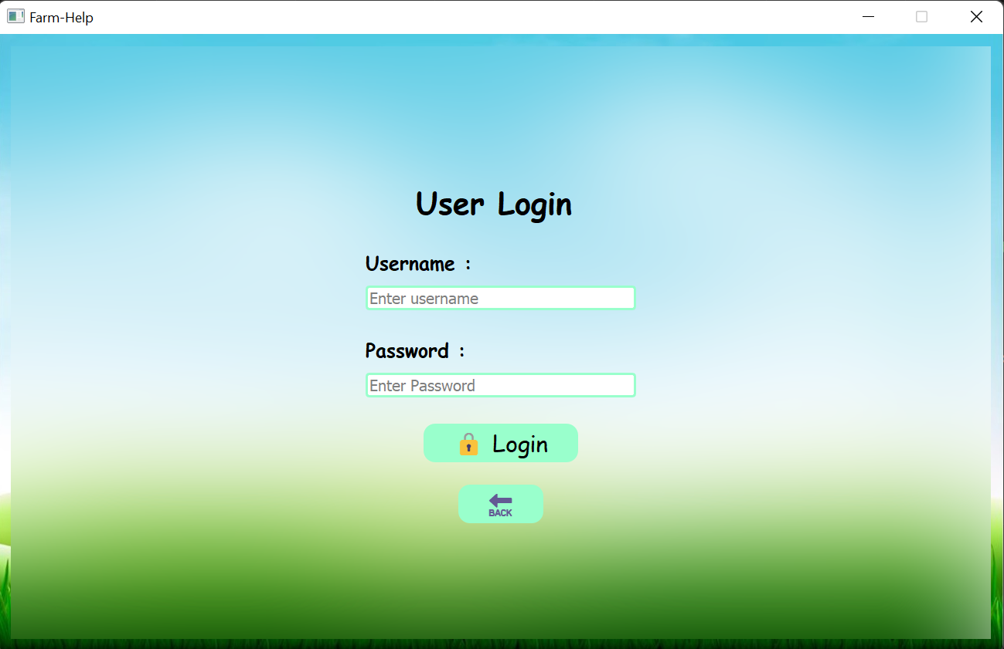
2. Loginpage:

Slide 12
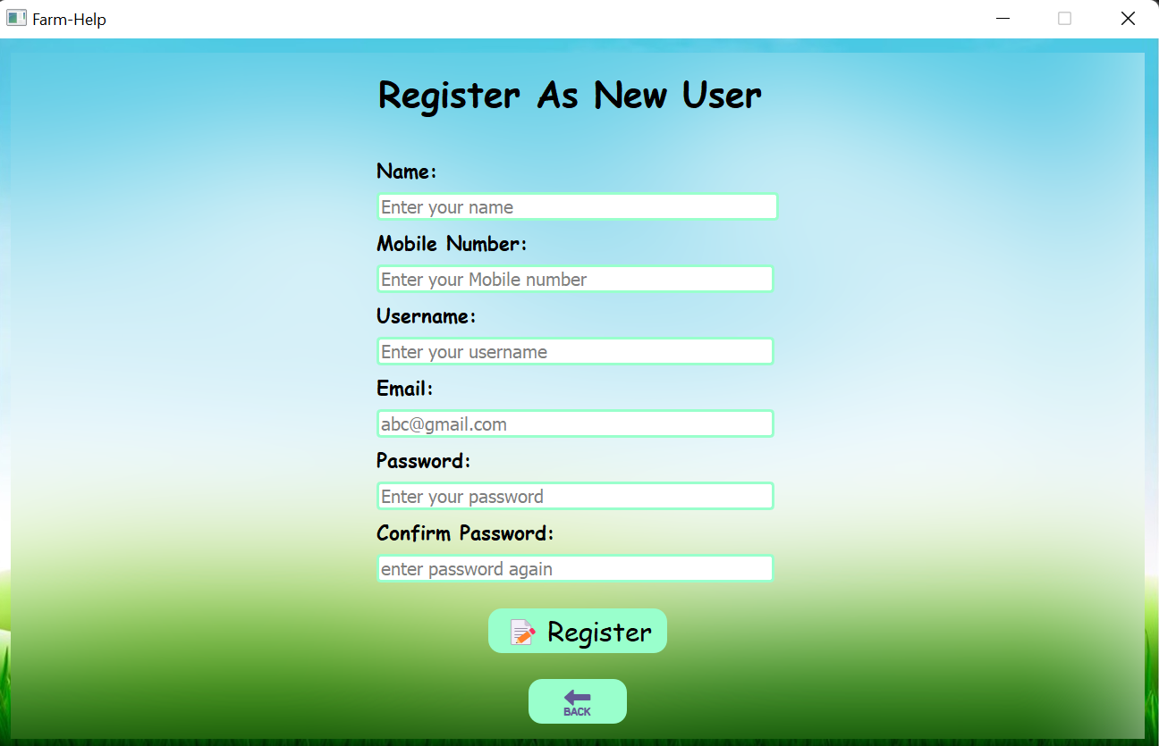
3. Registration pannel:

Slide 13
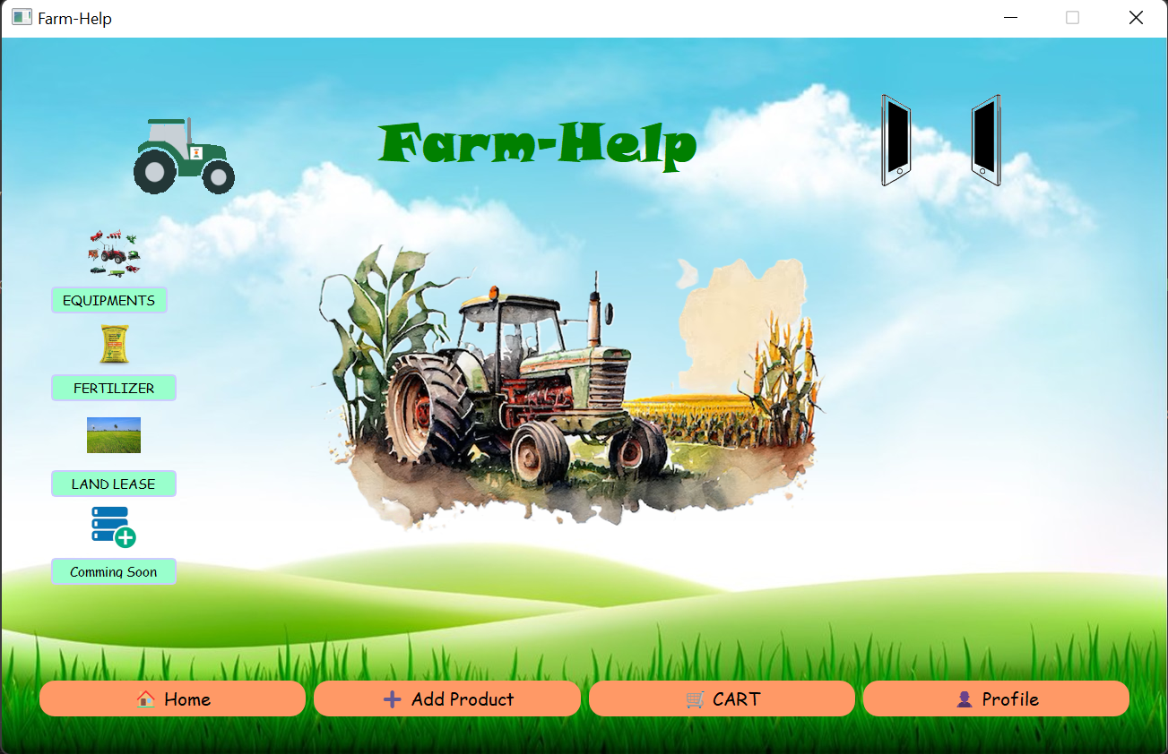
4. Landing page:

Slide 14
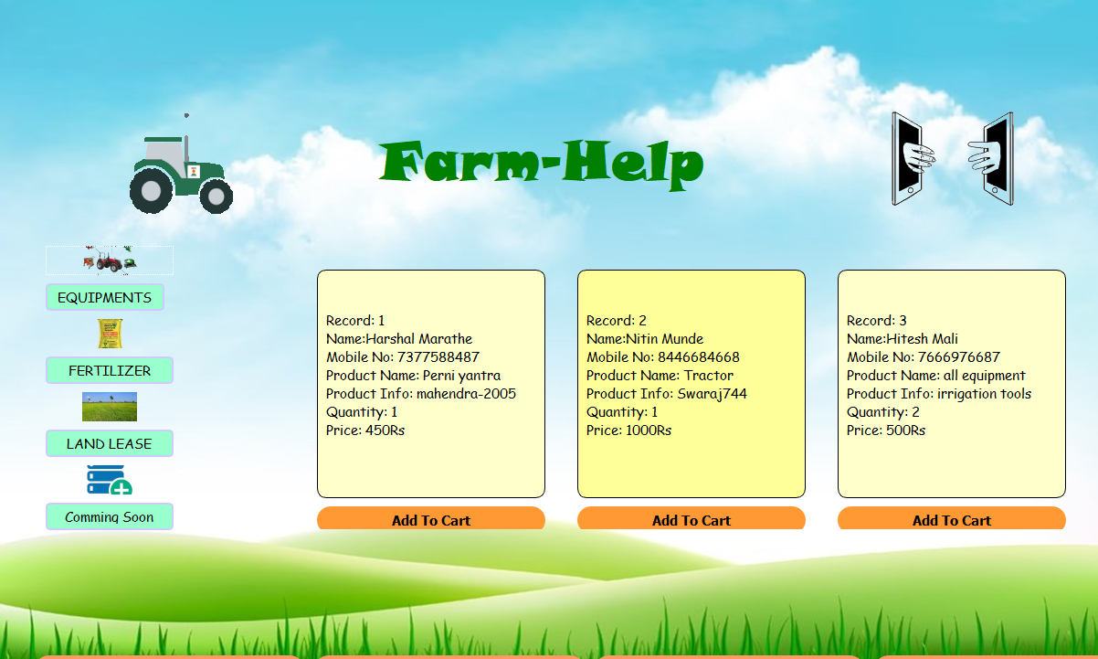
5. Equipments :

Slide 15
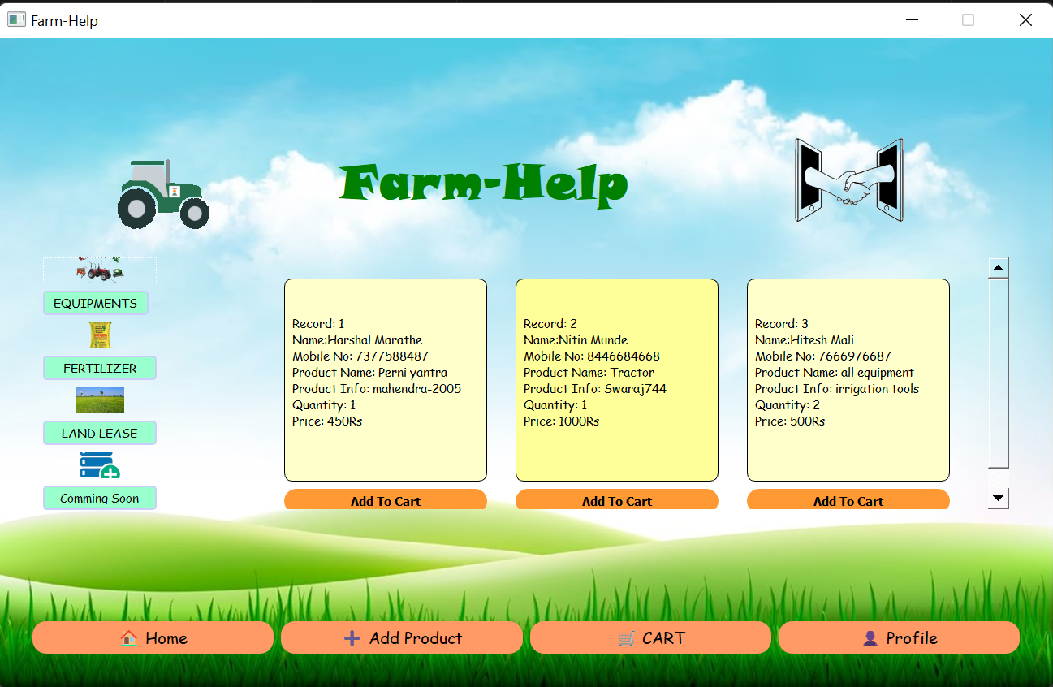
6. Add to cart pannel:

Slide 16
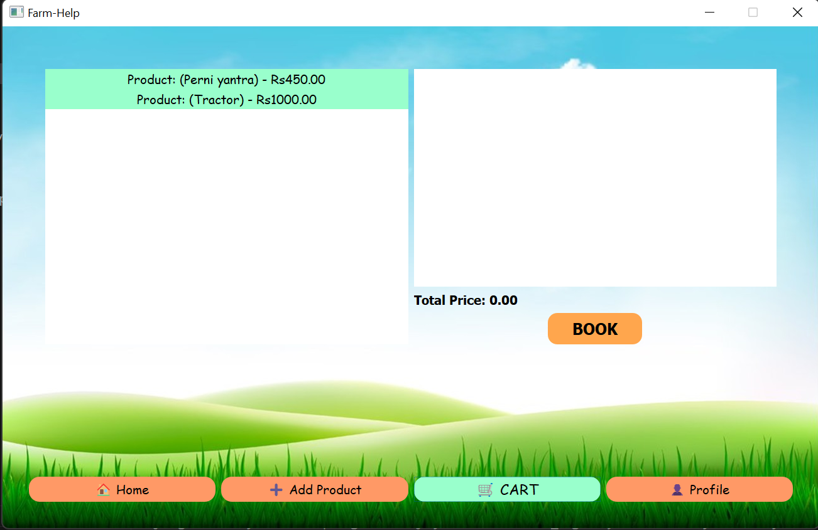
7. Purchase Request:

Slide 17
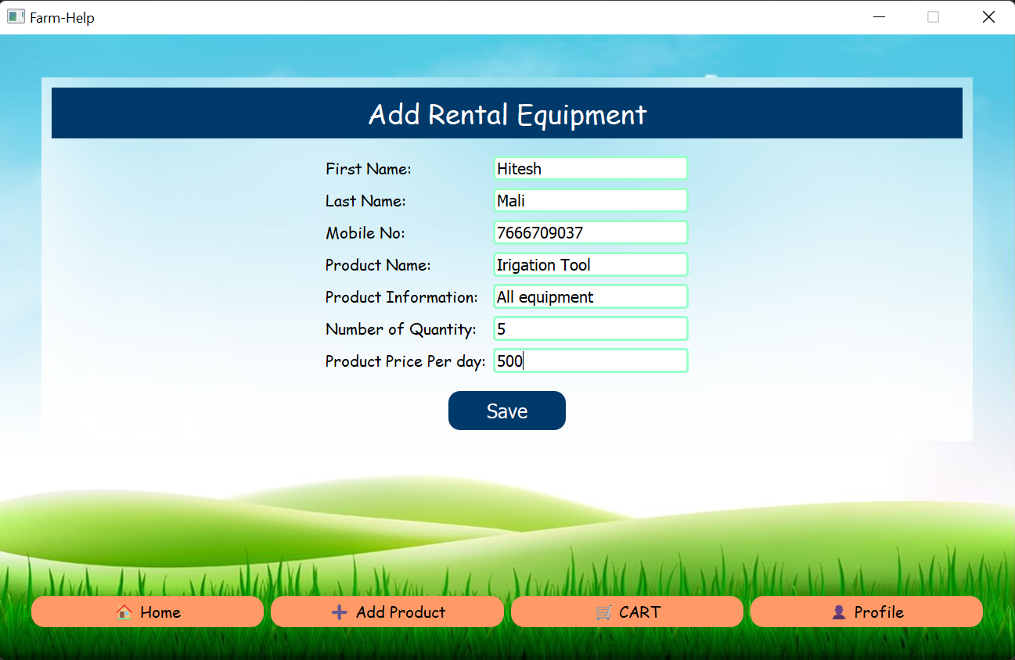
8. Equipment rental :

Slide 18
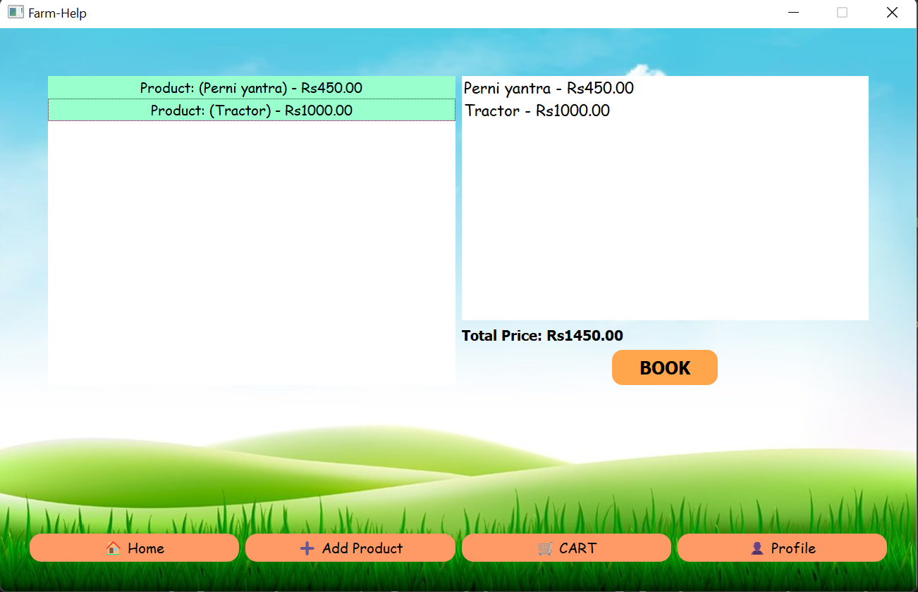
9. Payment process:

Slide 19
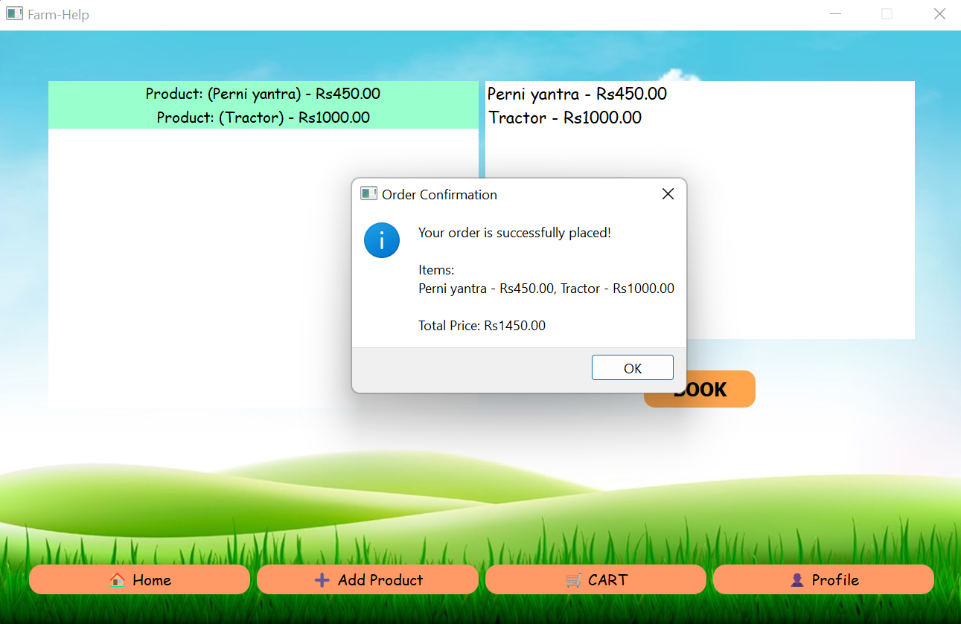
10. Order Confirmation:

Slide 20
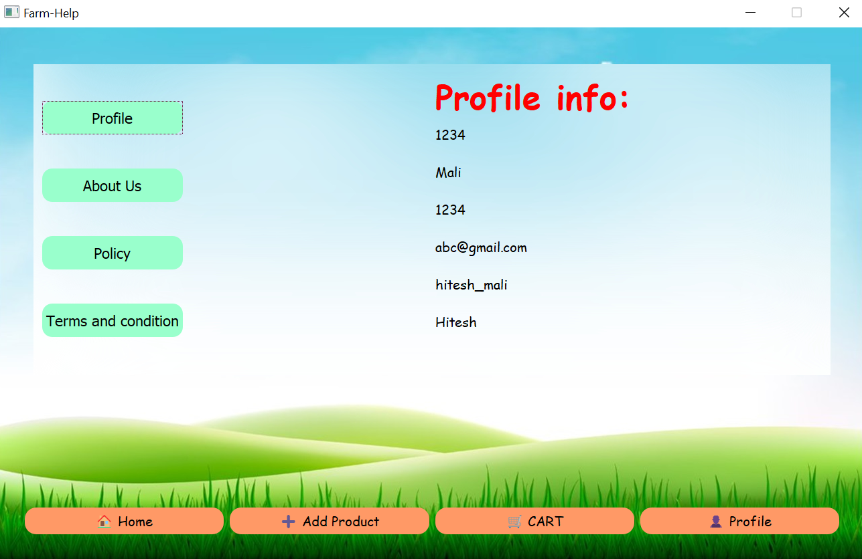
11. Admin Profile :

Slide 21
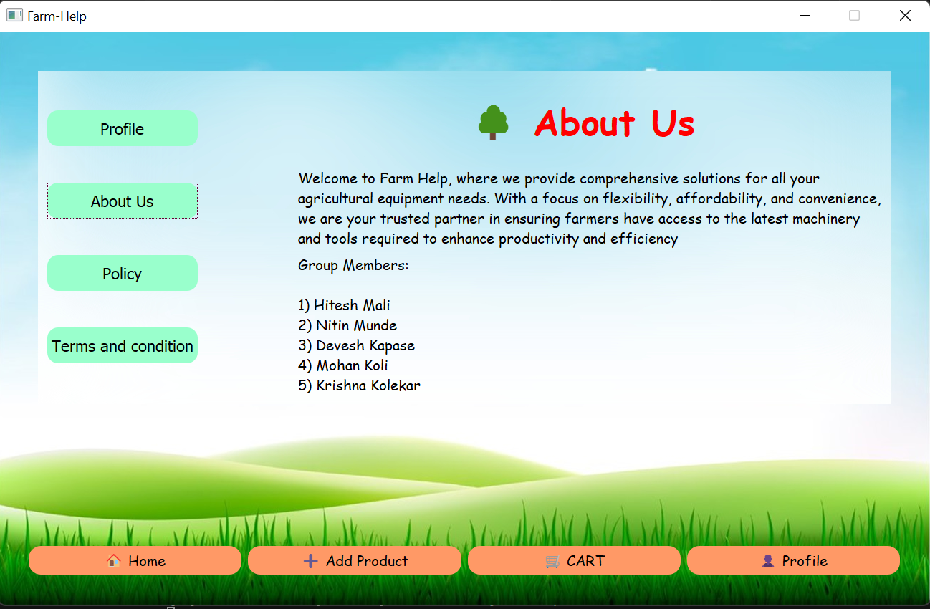
12. About Us:

Slide 22
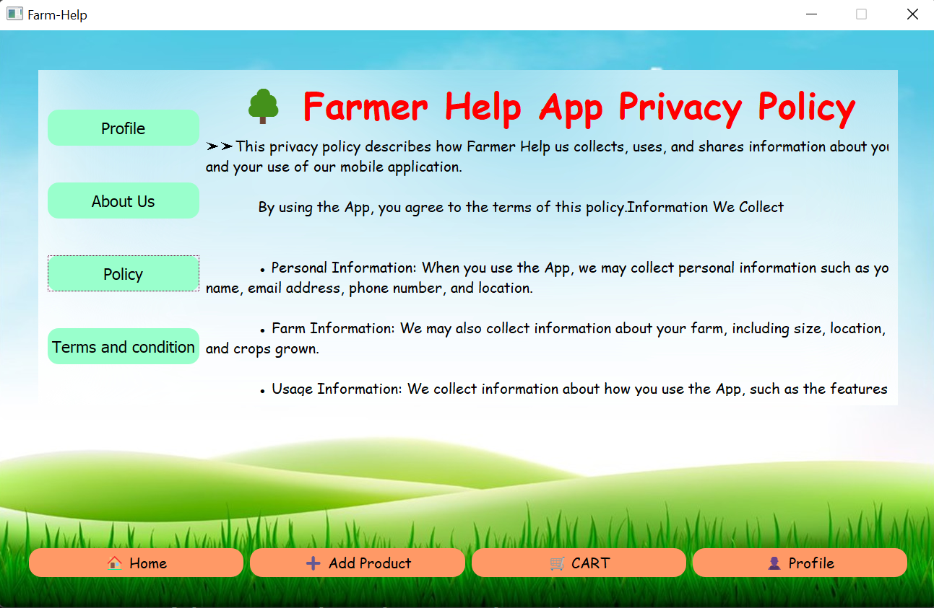
13. App Privacy Policy:

Slide 23
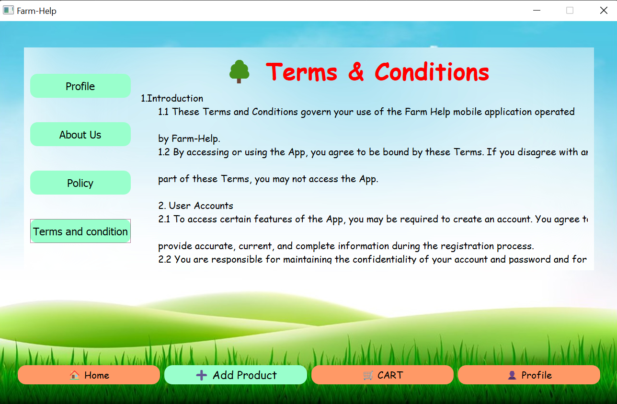
14. Terms and Conditions:

Slide 24
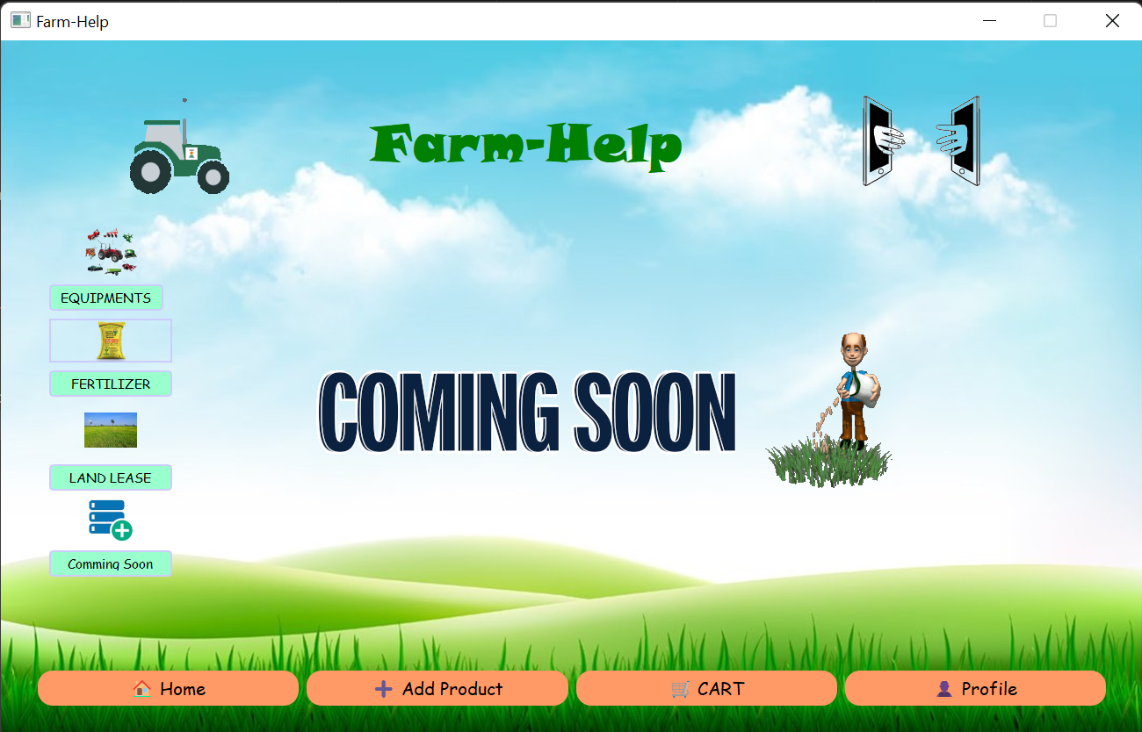
15. Coming soon products:

Slide 25
Conclusion
The online administration framework for Agri Equipment rental framework was made to guarantee the productive task and straightforward administration of a government-upheld farming hardware rental business It reduces the manual work.
It reduces the paper work, thus supporting the sustainable environment. It saves time also. Moreover, the proper documentation of whole project is also provided so that any-one can understand the project and can do the necessary changes if required.
This application can be improved in many ways and can be extended to support multiple devices.
The online administration framework for Agri-Equipment rental framework was made to guarantee the productive task and straightforward administration of a government-upheld farming hardware rental business It reduces the manual work. It reduces the paper work, thus supporting the sustainable environment.

Slide 26

References
Farm Business Management: Core Skills by P. L. Nuthall
https://proxy.library.mcgill.ca/login?url=http://www.cabi.org/cabebooks/ebook/20113297684
Encyclopedia of Agriculture and Food System, edited by N. K. Van Alfen
https://proxy.library.mcgill.ca/login?url=https://www.sciencedirect.com/referencework/9780080931395/encyclopedia-of-agriculture-and-food-systems
Agri Farm Mangement System
https://www.scribd.com/document/455028052/agri-farm-management-system
Kheti Buddy
https://khetibuddy.com/products/farm-management/ - :~:text=Farm%20management%20software%20can%20help,reduced%20costs%2C%20and%20improved%20yields.

Slide 27


Thank you
“Farm-Help Management.”
Presented by – Hitesh Prakash Mali

